Slide 1
The Rhema word
BE LIGHT SERIES

Slide 2

1)
The Rhema word.

Slide 3
Jesus answered, “It is written: ‘Man shall not live on bread alone, but on every word that comes from the mouth of God.’
(Matthew 4:4)

Slide 4
(Romans 10:17)
Consequently, faith comes from hearing the message, and the message is heard through the word about Christ.

Slide 5
(John 6:63)
The Spirit gives life; the flesh counts for nothing. The words I have spoken to you, they are full of the Spirit and life.

Slide 6
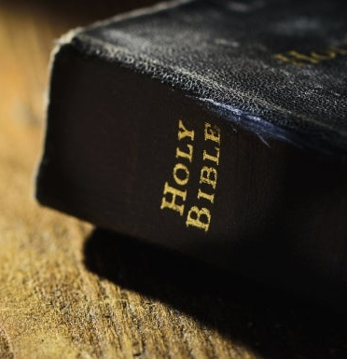
2)
A General promise and a specific one.

Slide 7
(Genesis 3:15)
And I will put enmity between you and the woman, and between your offspring and hers; he will crush your head, and you will strike his heel.

Slide 8
Therefore the Lord himself will give you a sign: The virgin will conceive and give birth to a son and will call him Immanuel.
(Isaiah 7:14)

Slide 9
(Luke 1:30-31)
But the angel said to her, “Do not be afraid, Mary; you have found favour with God. 31 You will conceive and give birth to a son, and you are to call him Jesus.

Slide 10
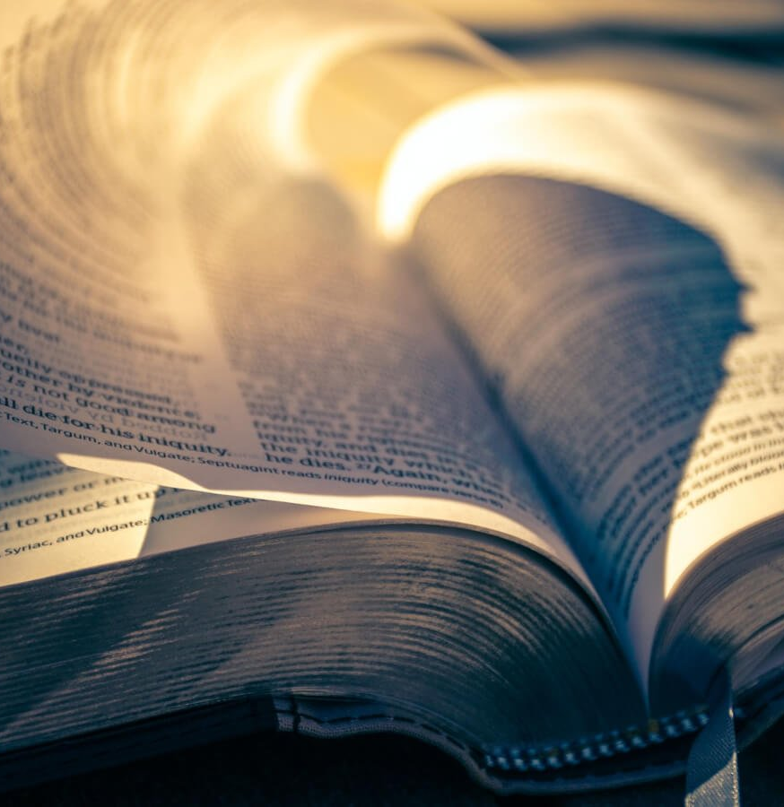
3)
Your Rhema word.

Slide 11
(Hebrews 8:5-7)
They serve at a sanctuary that is a copy and shadow of what is in heaven. This is why Moses was warned when he was about to build the tabernacle: “See to it that you make everything according to the pattern shown you on the mountain.” 6 But in fact the ministry Jesus has received is as superior to theirs as the covenant of which he is mediator is superior to the old one, since the new covenant is established on better promises. For if there had been nothing wrong with that first covenant, no place would have been sought for another.

Slide 12
(Proverbs 4:20-23)
My son, pay attention to what I say; turn your ear to my words. Do not let them out of your sight, keep them within your heart; 22 for they are life to those who find them and health to one’s whole body. 23 Above all else, guard your heart, for everything you do flows from it.

Slide 13
Do you have a word from God?

